Slide 1
Optimization using EXCEL
Dr. Majed Al-Ghandour, Ph.D., PE, CPM
malghand@uci.edu

Slide 2
Introduction to Optimization
All optimization problems have several common elements:
Decision variables—the variables whose values the decision maker is allowed to choose.
Objective function (objective) to be optimized—maximized or minimized.
Constraints that must be satisfied—physical, logical, or economic restrictions, depending on the nature of the problem.

Slide 3
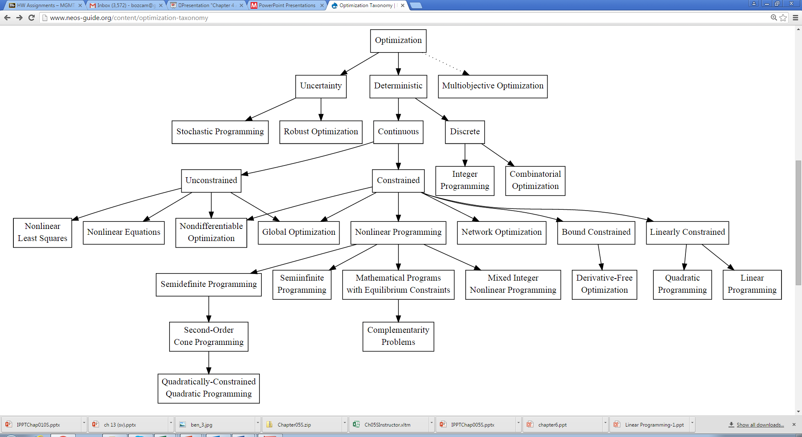
Optimization Problems
One specific type of optimization, linear programming (LP), is used in all types of organizations to solve a wide variety of problems

Slide 4
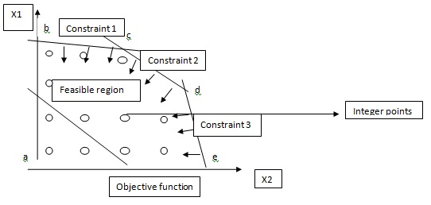

Slide 5
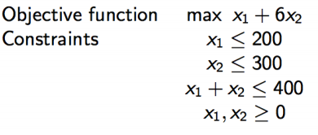
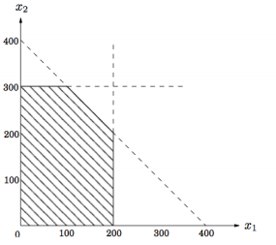
2
Decision variables
1
3
Constraints
Simplex Method
Decision variable
Optimum Point
a line in the two-dimensional (2D) plane
feasible region:
polygon
Decision variable

Slide 6
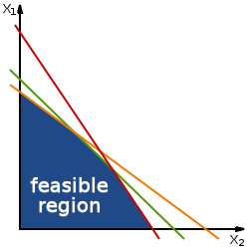
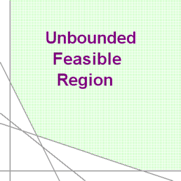

Slide 7
Example

Slide 8
#1: A Two-Variable Product Mix Model (PC Models)
Objective: To use LP to find the best mix of computer models that stays within the company’s labor availability and maximum sales constraints.
Solution: PC Tech company must decide how many of each of two models, Model1 and Model2, to produce to maximize its net profit.
The most it can sell are 600 Model1 and 1200 Model2.
Each Model1 sells for $300 and each Model2 for $450.
The cost of component parts for a Model1 is $150 and for an Model2 is $225.
There are at most 10,000 assembly hours and 3000 testing hours available.
Each Model1 requires five hours for assembling and one hour for testing, and each Model2 requires six hours for assembling and two hours for testing.
Each labor hour for assembling costs $11 and for testing costs $15.

Slide 9
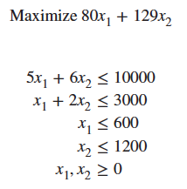

5*$11 +1*$15 +$150-$300=$80
6*$11 +2*$15 +$225-$450=$129

Slide 10
Video
https://app.vidgrid.com/view/2Se2SNsBF9Yr
https://use.vg/EnS2cP

